Slide 1
Plan of Action

Slide 2
Basic Steps
The planning Stage
The Acting Stage
The developing Stage
The reflecting Stage

Slide 3
Overview of the Action Research
Identifying and limiting the topic
Gathering Information
Reviewing the related literature
Developing a research plan
Implementing the plan and collecting the data
Analysing the data
Developing the Action plan
Sharing and Communicating the results
Reflecting on the process

Slide 4
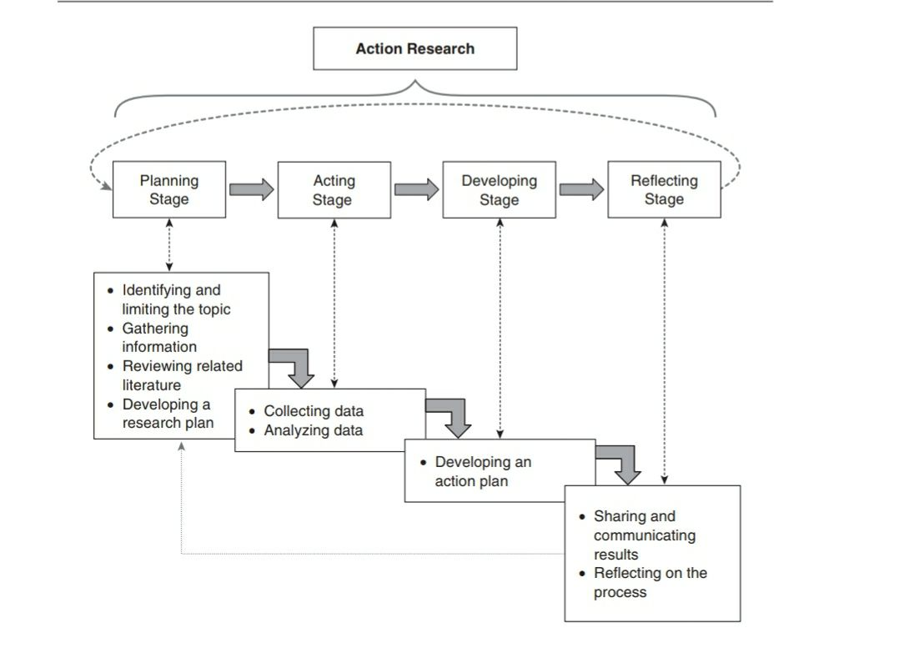

Slide 5
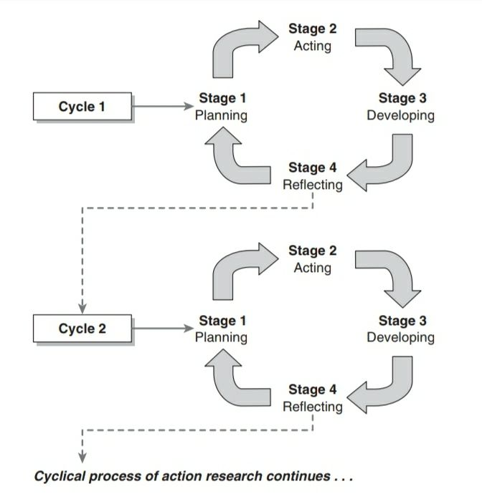
The Process Of Action Research

